Slide 1

NYC Taxi Fare Analytics
Zien Zhu
Lida Wei
Ives He
Jimmy Chen
Jingyi Zhao

Slide 2
Agenda
Trip Demand Patterns: Demand by location and time
Payment Type Analysis: Variations across trips
Passengers vs. Distance: Correlation analysis
Surcharges and Travel Trends: Location and time correlations
Fare Clustering Analysis: Segmenting fare patterns

Slide 3
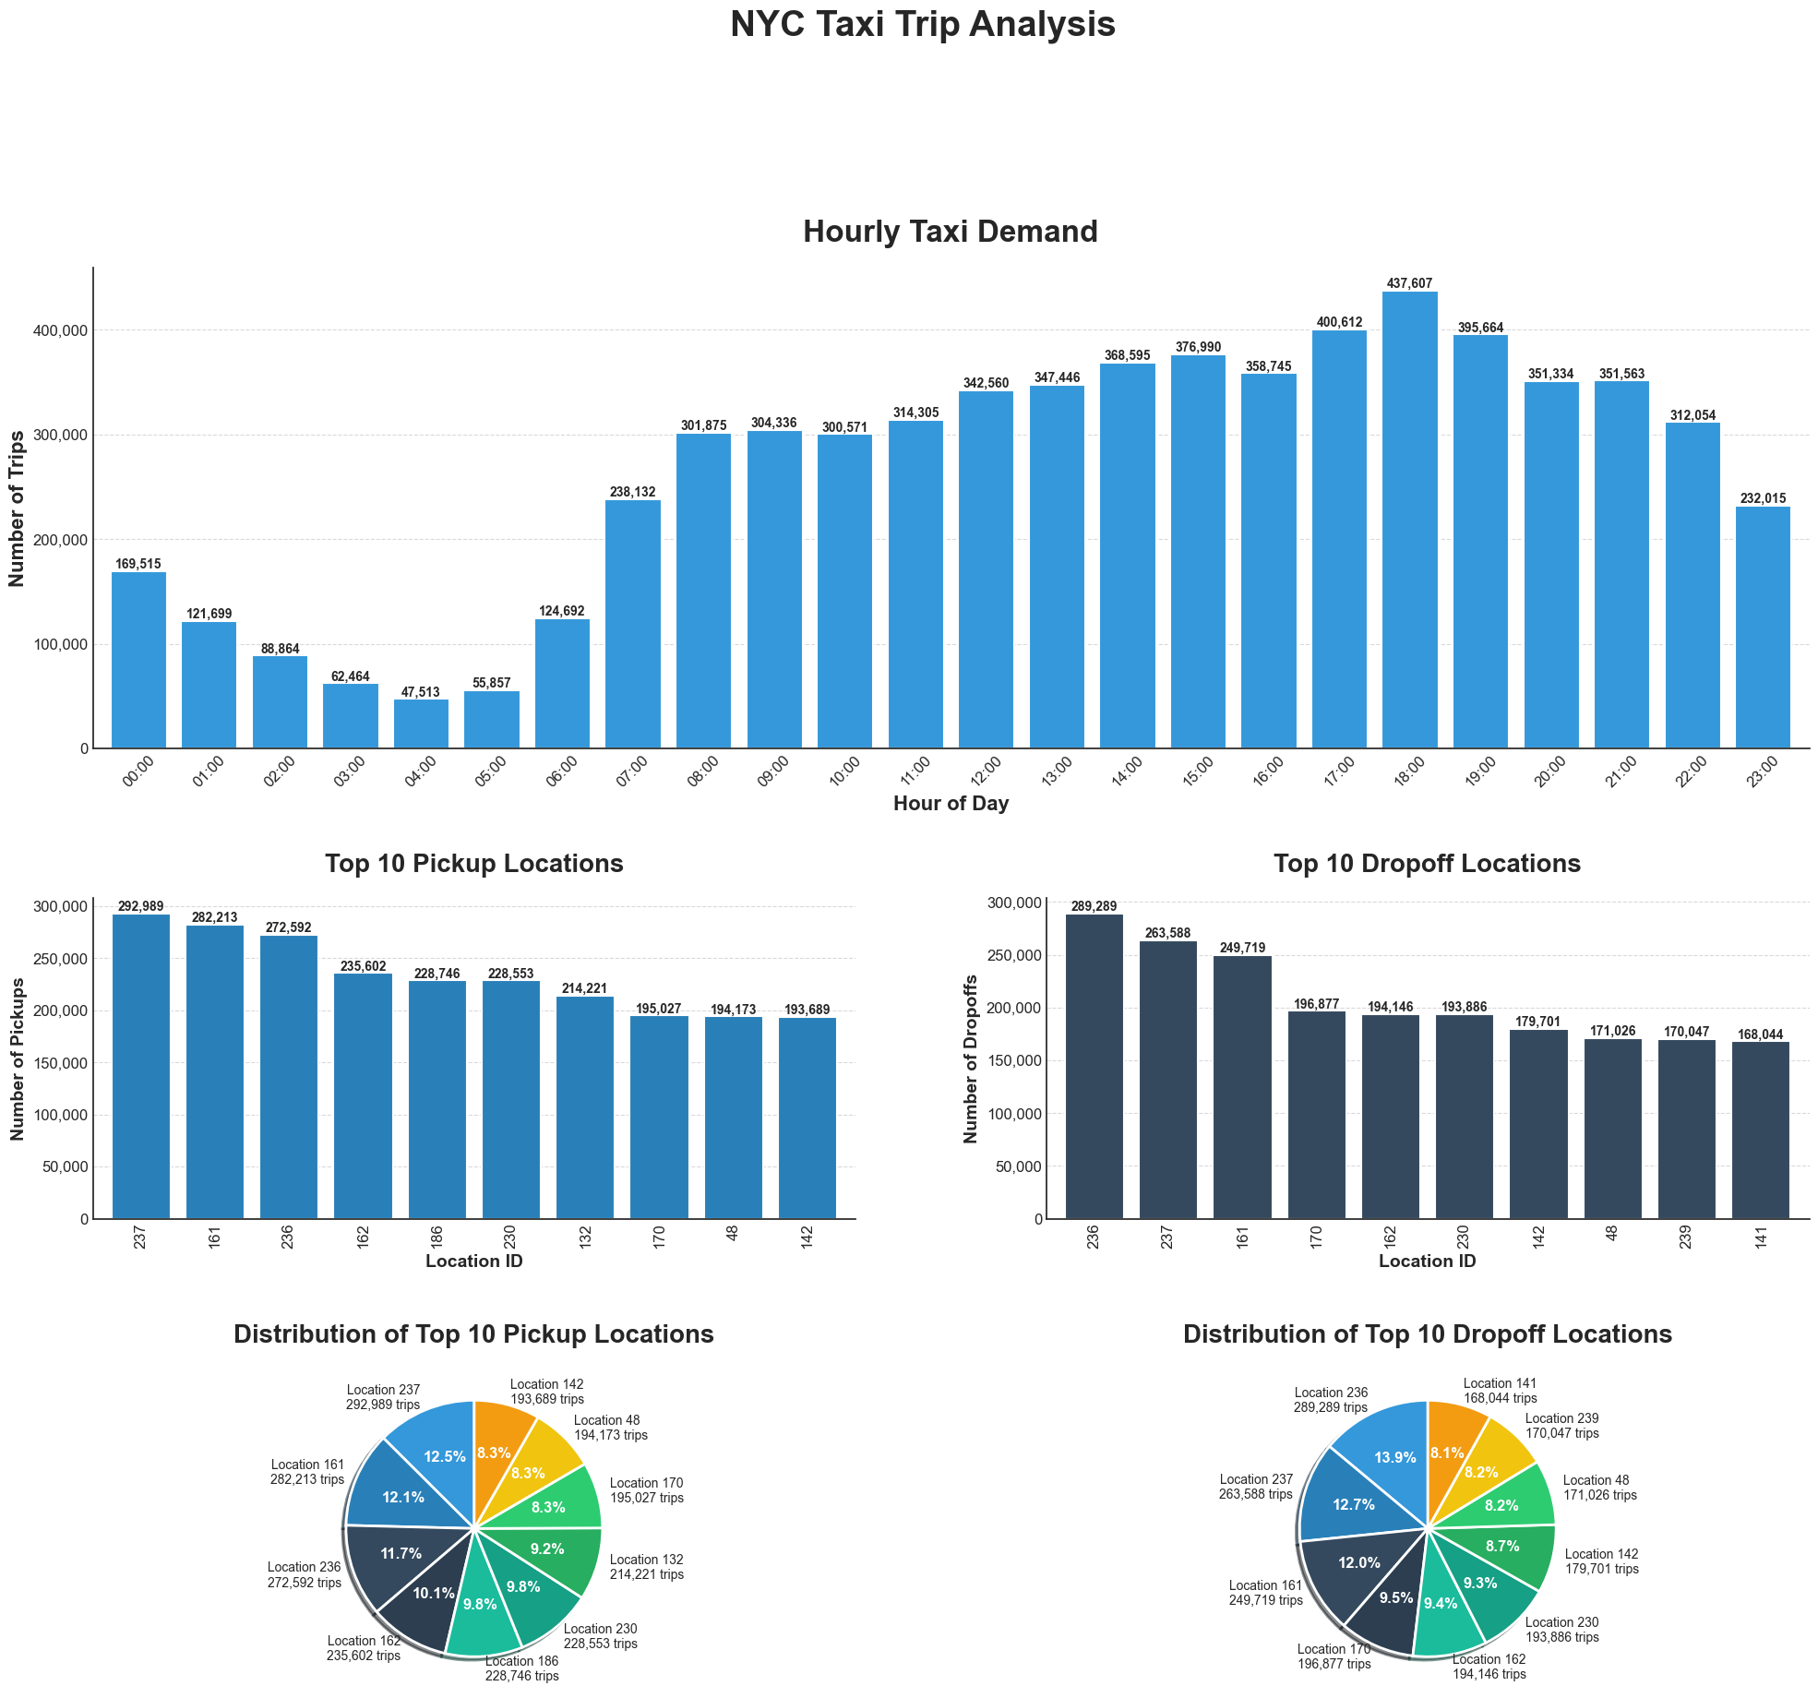
Identify patterns in trip demand by location and time
Peak hourly taxi demand occurs at 17:00 with over 400,000 trips.
Lowest hourly demand is at 04:00 with around 55,000 trips.
Top pickup location is ID 237 with 292,369 trips.
Top dropoff location is ID 236 with 289,289 trips.
Pickup locations are evenly distributed among the top 10, showing consistent demand.
Dropoff locations have similar patterns, with slightly higher counts for the top location.

Slide 4
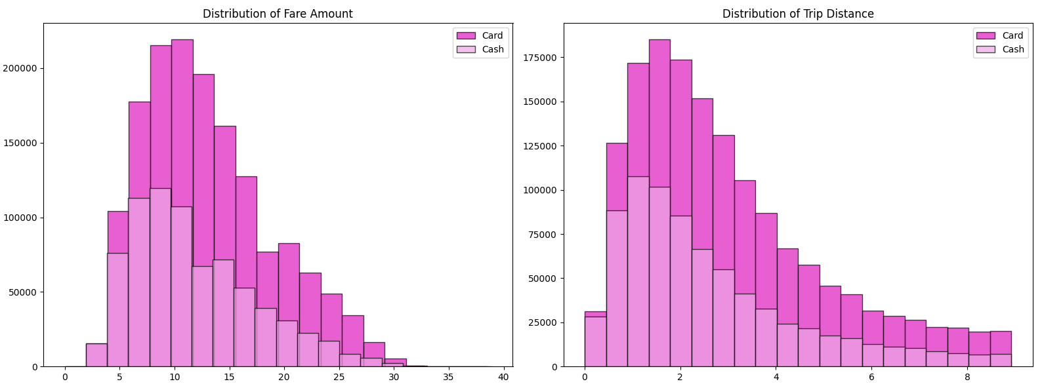
Payment Types vary across Trips
Card payments dominate mid-to-long distances with higher fares.
Cash payments are more frequent in shorter, lower-cost trips.

Slide 5
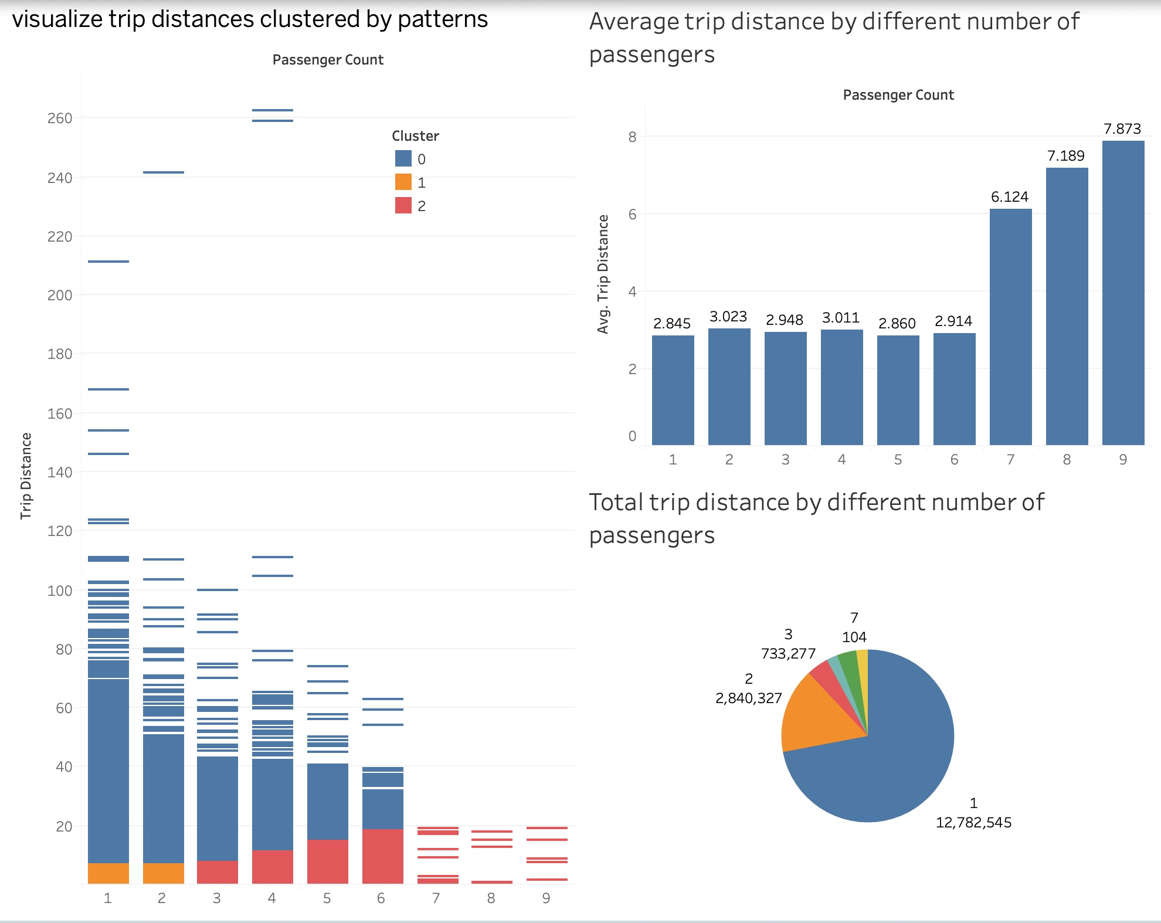
Analysis of the relationship between the number of passengers and trip distance
Total trip distance segmented by passenger count
Relationship between the number of passengers and the average trip distance
Different types of trips based on trip distance and passenger count (Cluster by the method of K-mean Cluster)

Slide 6
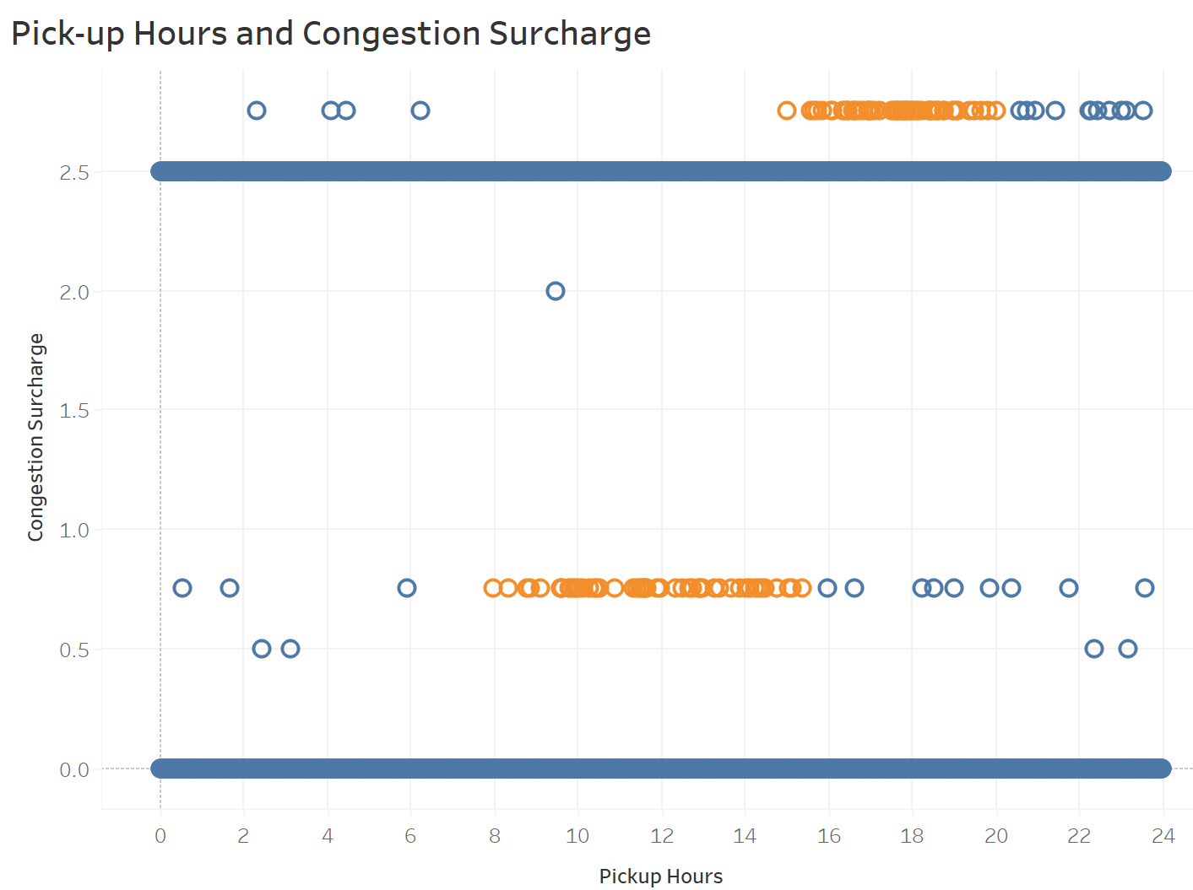
Figure out how do surcharges correlate with travel locations and time
Surcharges tend to increase around 9:00 to 13:00 in the morning, and there is a denser and higher increase in surcharges between 17:00 and 19:00 in the evening
From 9:00 to noon, most people are commuting to work, leading to a slight increase in congestion surcharges.
Between 17:00 and 19:00, many people commute home, while others shop, dine, and engage in leisure activities, contributing to a notable increase in congestion surcharges.

Slide 7
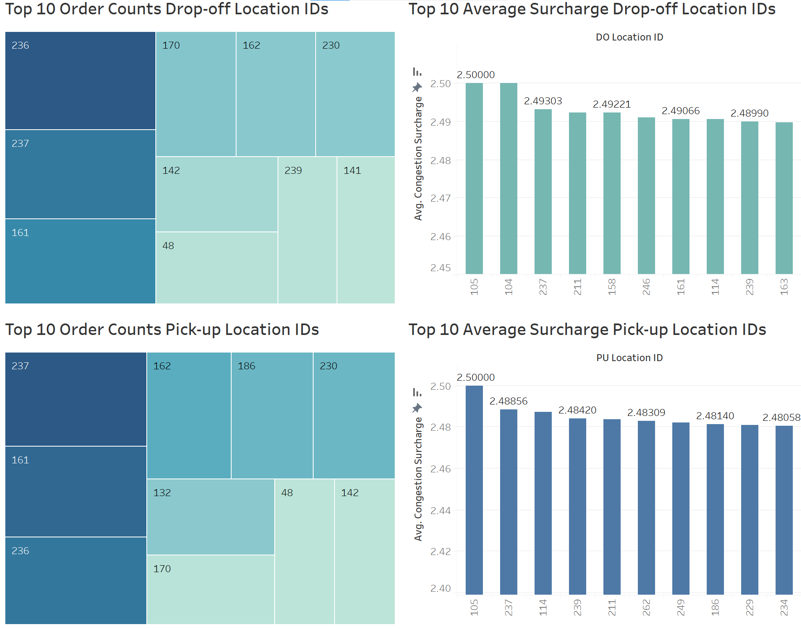
Figure out how do surcharges correlate with travel locations and time
In the location ID: 161, 237 and 239, people always have high congestion surcharge and high order density.
'239':Upper West Side South: Columbia University, American Museum of Natural History, Lincoln Center
'161': Midtown Center: Times Square, Madison Square Garden. Midtown Center has many advertising agencies, financial companies, etc.
'237':Upper East Side South: Museum Mile: boasting several world-renowned museums. One of New York City's wealthiest neighborhoods, including major medical centers

Slide 8
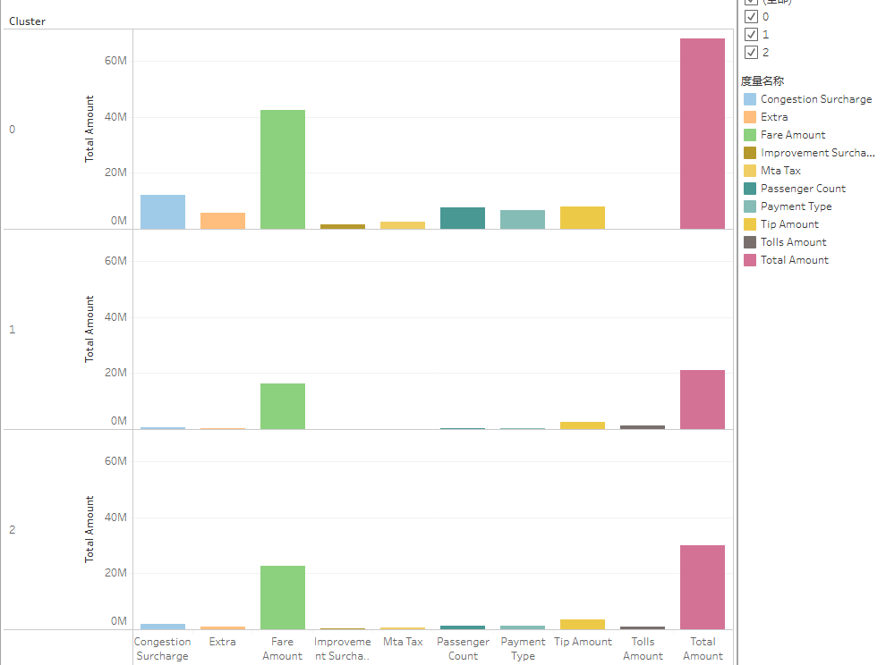
Fare Amount K-mean Clustering Analysis
Cluster 0: This group contributes the most to the total fare amount.
Cluster 1: This group contributes the least to total fare amount.
Cluster 2: This group contribute intermediate to total fare amount.
Based on the cluster group, we can visualize how these group distributed geographically in the New York State:
Cluster 0 active in Manhattan
Cluster 1 mostly active in JFK Airports and few in Manhattan
Cluster 2 actives in LGA and Manhattan
Tableau Link

Slide 9
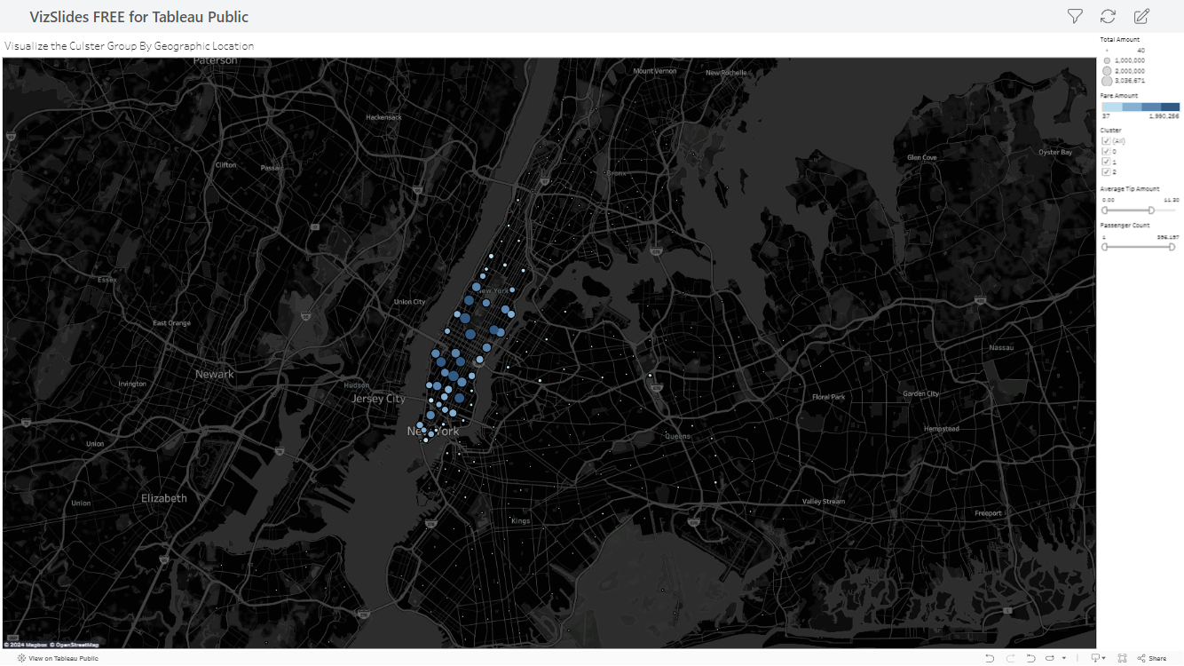

Slide 10
Conclusion
The clustering reveals critical zones (e.g., Manhattan and airports) where demand and profitability are concentrated.
Optimizing operations around time, location, and trip type can significantly improve profitability and efficiency.
Develop a dynamic pricing model and driver allocation strategy are essential for capturing maximum value.
Actionable Plans based on cluster analysis:
Optimize fleet allocation in Manhattan, especially during peak hours, and advertise premium services based on different fare amount locations.
Develop specialized airport transfer routes, align driver schedules with flight timings, and promote partnerships with airlines or hotels.
Implement dynamic pricing during peak hours, incentivize drivers for better coverage, and enhance fleet management for timely availability.

